Slide 1
ENGL 2121 BRITISH LITERATURE I
Librarian: Abbie Holmes, MLIS, MA

Slide 2
HAVE QUESTIONS? CONTACT ME:
Abbie’s Contact Info:
Phone: (478) 471-2093
Email: abbie.holmes@mga.edu
Office 137
Macon Campus Library:
Phone: (478) 471-2093
Text a librarian: (478) 285-4898
Chat with a librarian via www.mga.edu/library

Slide 3
SEARCH TECHNIQUES

Slide 4
BOOLEAN OPERATORS
What are they?
Terms that tell the database how to connect words and conduct your search.
AND: Connects several terms to get fewer results
OR: Connects several terms to get more results (either or)
NOT: Eliminates a term in the results lists

Slide 5
TRUNCATION
A technique that broadens your search to include various word endings. By adding truncation to your search string, the database will return results that include any ending of your root word.
To use:
Enter the root of a word and put the truncation symbol (*) at the end
Example:
litera* = literature and literary

Slide 6
SEARCH QUOTES
A technique that narrows your search to include only the words within quotation marks and in the order given.
To use:
Place quotation marks around phrases, concepts, and names with two or more words.
Examples:
“Henry V”
“Battle of Agincourt”
“Edmund Spenser”
“Redcrosse Knight”

Slide 7
HOW TO LOCATE SOURCES

Slide 8
TYPES OF RESOURCES AVAILABLE THROUGH THE LIBRARY
Books in both print and electronic format:
MGA Collection (GIL-Find)
University System of Georgia Collections (GIL-Express)
Interlibrary Loan
Academic Journal Articles in both print and electronic format:
GIL-Find
Journals A-Z
GALILEO
Interlibrary Loan
All of these resources and services can be accessed from the Library’s home page.

Slide 9
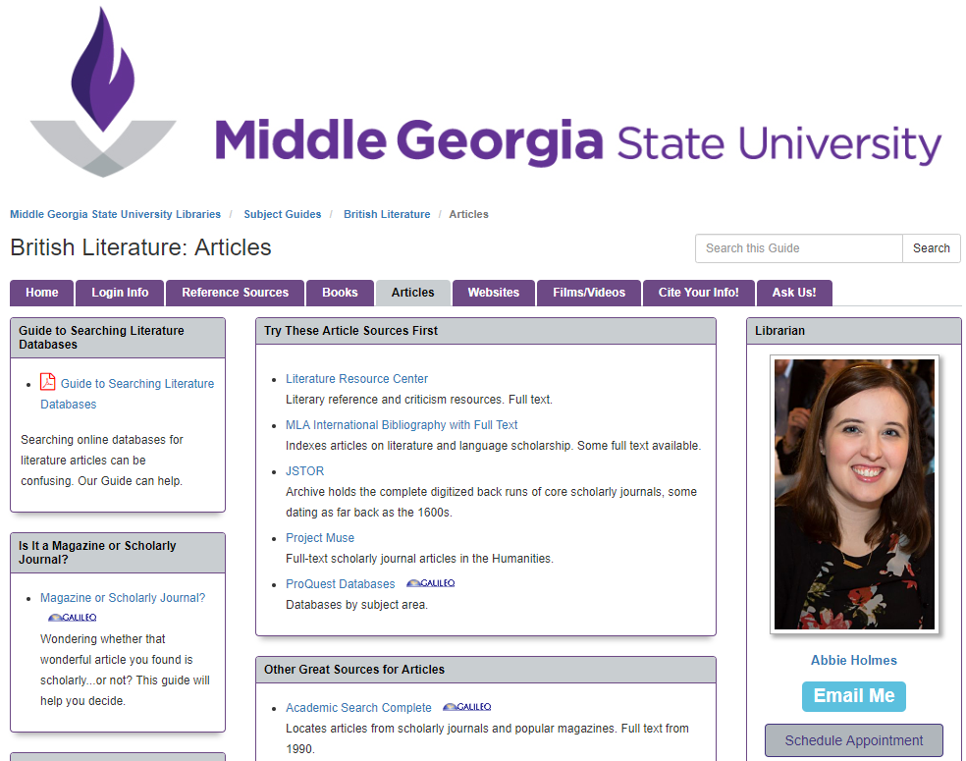
WHERE TO START: BRITISH LITERATURE SUBJECT GUIDE
http://guides.mga.edu/c.php?g=456221

Slide 10
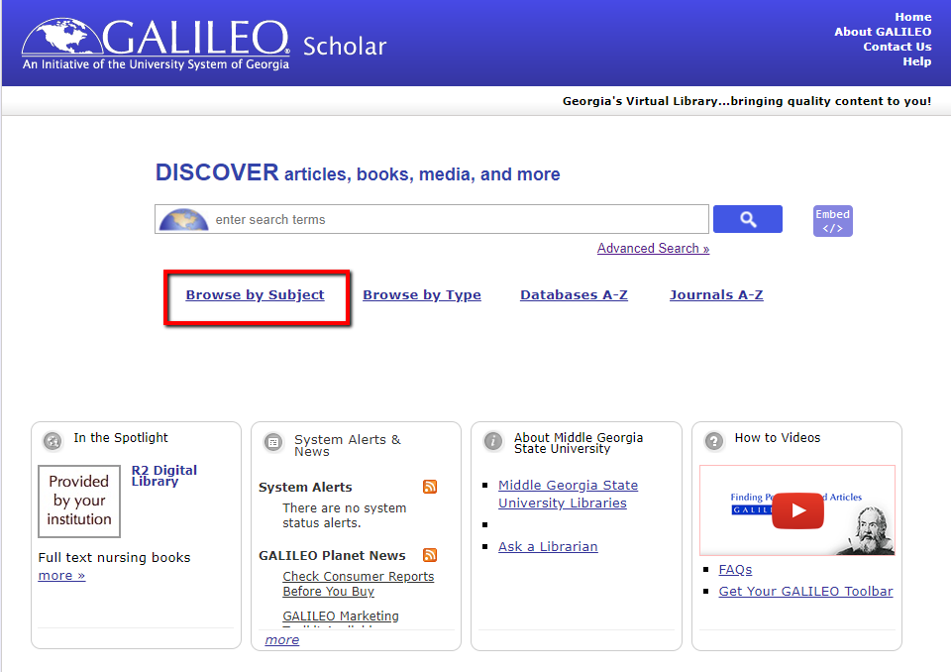
HOW TO FIND AN ARTICLE IN GALILEO

Slide 11
WHAT IF WE DON’T HAVE THE BOOK OR ARTICLE YOU ARE LOOKING FOR?
Article
Book
Use Interlibrary Loan to order the article.
How long will it take to receive the article?
Interlibrary Loan = 1 – 2 weeks
Use GIL Express or Interlibrary Loan to order the book.
How long will it take to receive the book?
GIL Express = approx. 1 week
Interlibrary Loan = 1 – 2 weeks
Remember: Leave yourself plenty of time when submitting a request.

Slide 12
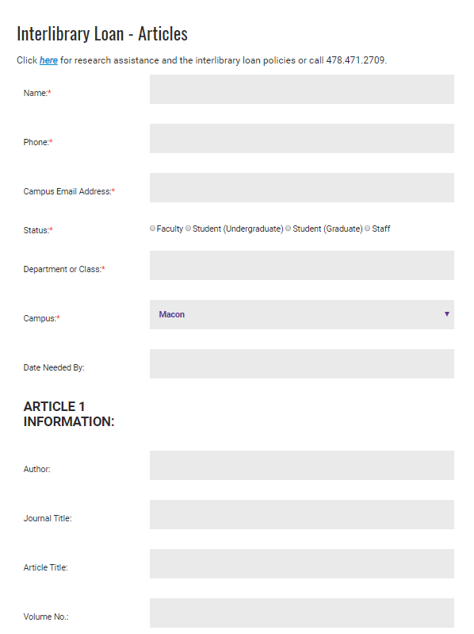
Interlibrary Loan
If you find a book or article that we do not have access to but that you would like to use, we can order it for you!
Interlibrary Loan (ILL) is a library service that allows you to access sources from other libraries.
Want to request an item? Visit this site to fill out a request form. Remember to give yourself plenty of time for the item to come via email or snail mail.

Slide 13
Having trouble locating a book or article? Ask a librarian for help! Phone: (478) 471-2093 Text a librarian: (478) 285-4898 Chat with a librarian via: www.mga.edu/library

Slide 14
As You Research, Remember:
Research is a process of trial and error. Don’t get discouraged if you can’t find what you are looking for. Try other search terms (think of synonyms for your terms).
If you are having trouble finding what you need, let us know and we will help. That’s what librarians are here for!
Always make sure to email yourself a copy of any articles that you think might be useful and take notes as you search to avoid repeating unsuccessful searches.

Slide 15
Please take this survey!
https:/www.surveymonkey.com/r/studentslibraryinstruction
Click on the shortcut called “library survey” on the computer desktop.
Password: library
Librarian: Abbie Holmes

